Slide 1
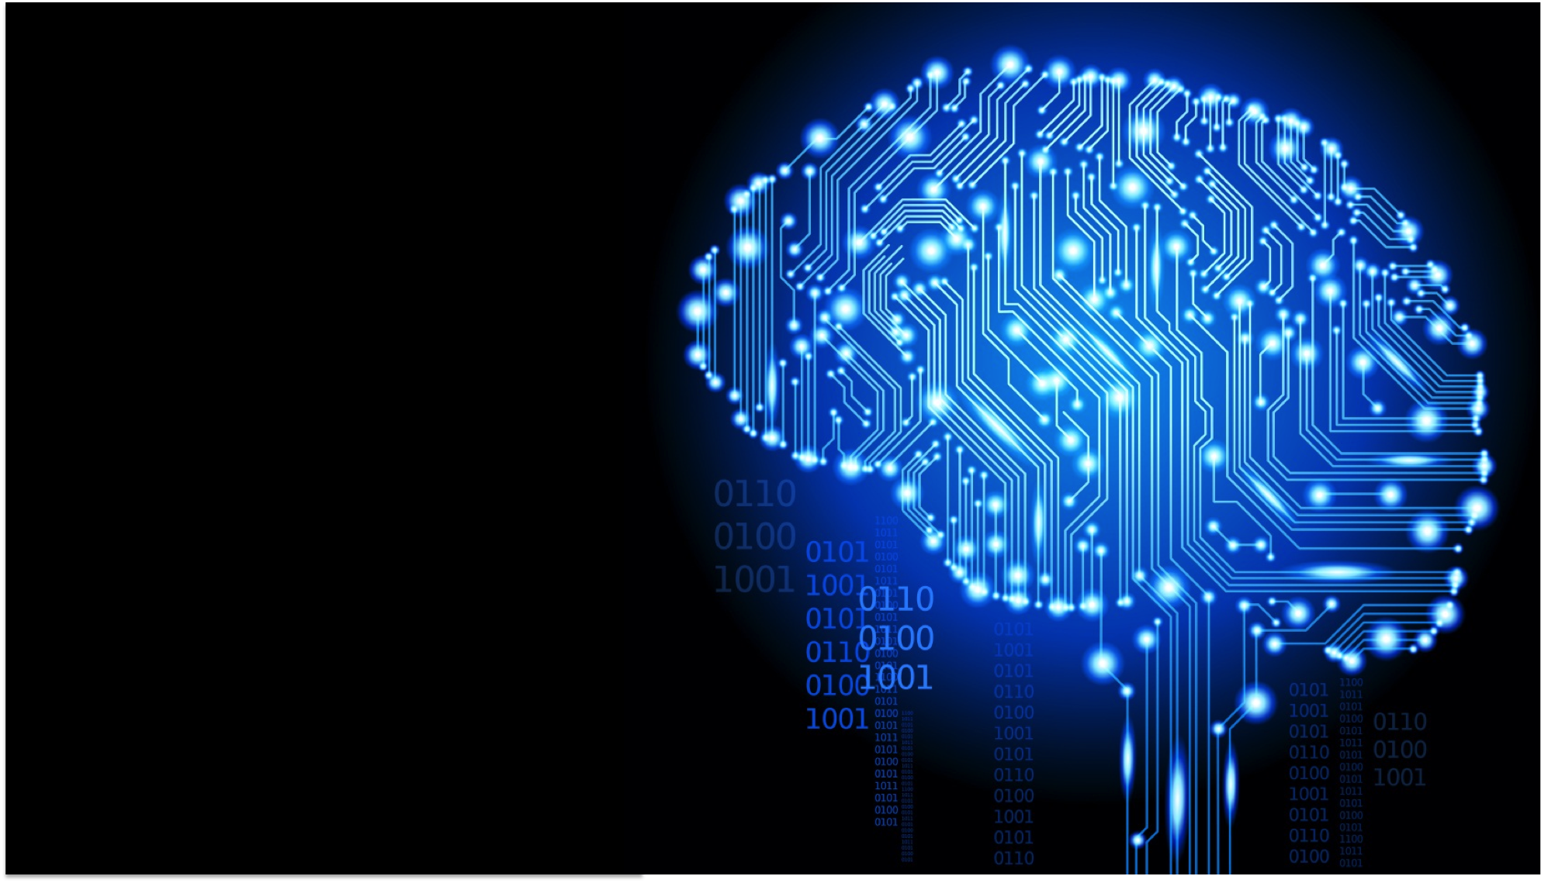
PedictHERS #ReWRITE
Mounika Gandavarapu
Radhika Bhati
Jayashree Subramanian
Meghna Prabhu
Athira Nambiath Asokan
Vipanchi Chacham

Slide 2
“Innovation is creation of new and rearranging of old in a new way”

Slide 3
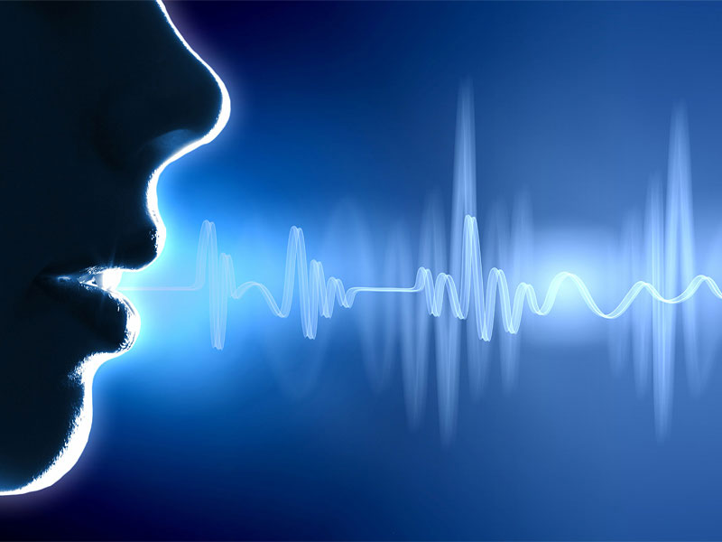

Automated Underwriting
Simplifying the form filling process in underwriting and recommending the desired insurance products based on company profile.
Google Assistant
Business Value-Add
Increasing number of clients per agent
Reduces the time
Improves efficiency
Eases the time-consuming process
Technologies Used
Chatbot AI
NLP
Google Home
Conversational UI

Slide 4

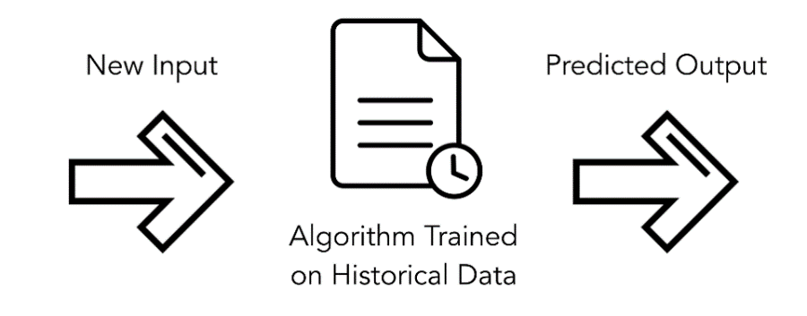
Predictive Modelling
A predictive machine learning model is built from the sensor data for alerting the customers with a warning SMS message and an email.
Business Value-Add
Dynamic
Automated
Predicts a hazard in prior and alerts the customers
Usage based Insurance (Pay-per-use)
Technologies Used
Python 3.0
Machine Learning
IoT (Sensor Data)
SMS/E-mail

Slide 5

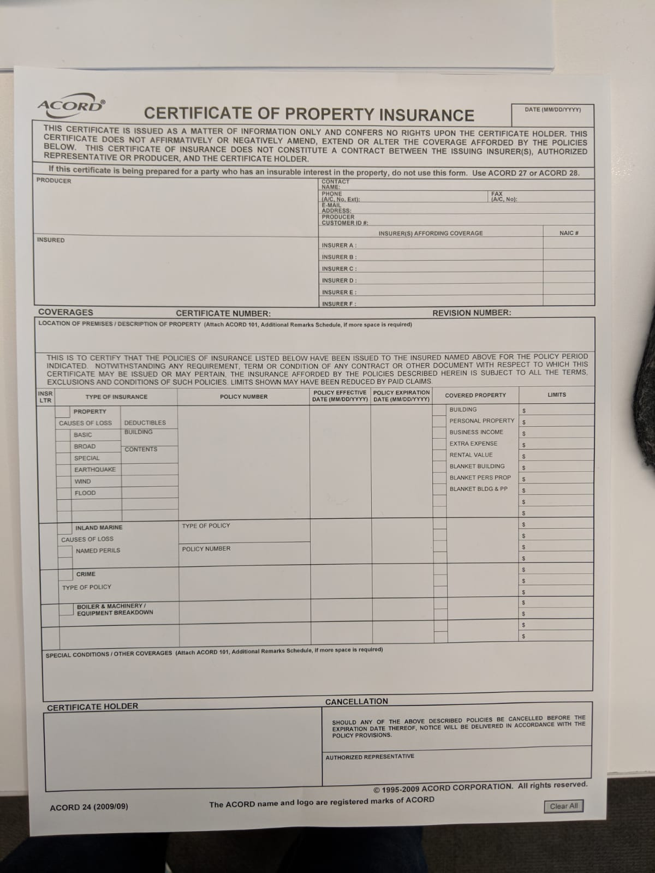
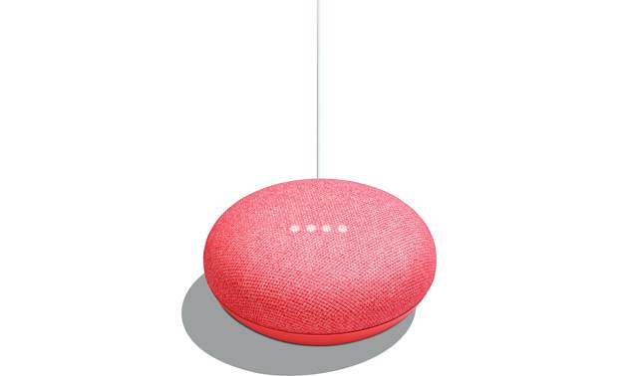

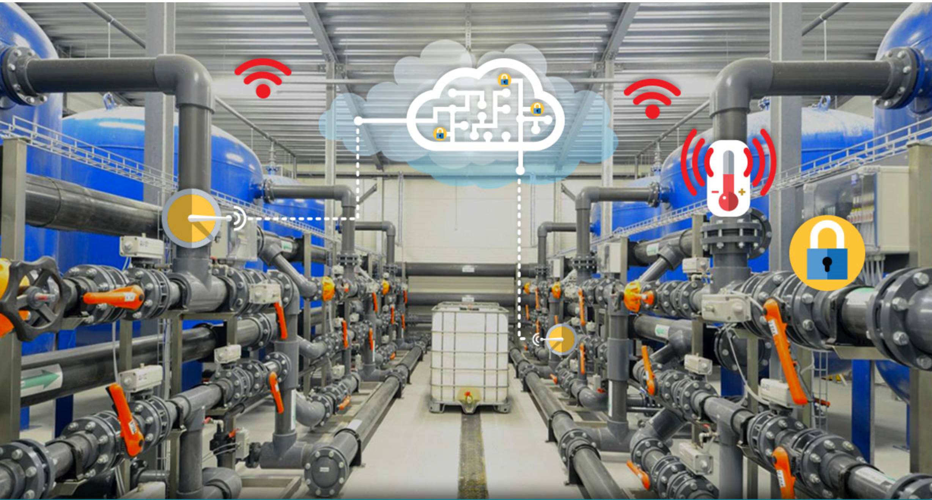



Proposed Methodology
Marsh Insurance Form
IoT Sensors
Data Analysis

Slide 6

Business Model
Predict-hers - Benefits
No need to spend all the insurance money on companies
Additionally paid for sensor-prediction model
Builds trust and retains companies from withdrawing
Client - Benefits
Needn’t claim entire insurance
Saves property from destruction
Premium reduces if not used every year

Slide 7
Future Work
Extending it to all types of Hazards in all sectors
Automating end-to-end Underwriting process
Try with advanced Machine learning algorithms like Neural network, CNN, etc.
Expanding to different areas

